Slide 1
General Expectations
Effort: I expect your best effort at all times. This includes being prepared, participating actively, and asking for help.
Respect: I expect that you will be respectful to all other classroom members, at all times. This includes behaving appropriately.
Responsibility: I expect you to take responsibility for both your effort and your behavior.

Slide 2
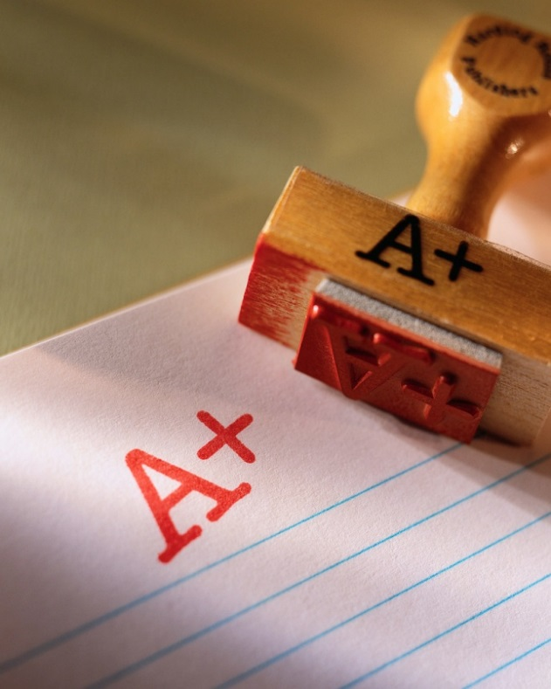
Grading
You will be graded on the following four categories:
Behavior
Participation
Attire
Assessments

Slide 3
Contact and Communication
E-mail: kmaloney@winchesterps.org
Website: https://mccallpedept.weebly.com/
Google Classroom: Announcements, Assignments and Assessments
Aspen: Progress Reports and Grade Reports

Slide 4
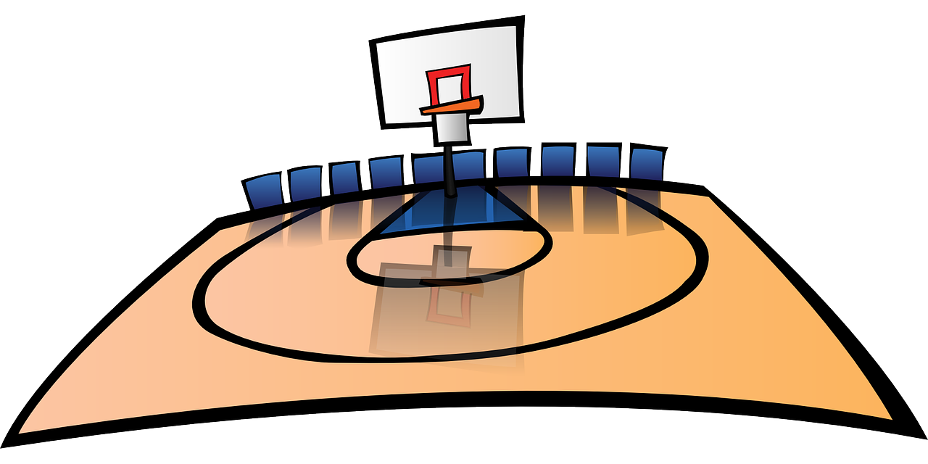
Daily Class Procedures
Arrive on time to the area outside the PE locker rooms and offices. A PE teacher will greet you and send you up the stairs to the gym. Once in the gym, please begin your Do Now activity.
Warm-up and Squad Lines for Attendance
Class Expectations and Instruction
Class Activities and Games
Clean-Up
When the bell rings, please wait to be formally dismissed.

Slide 5
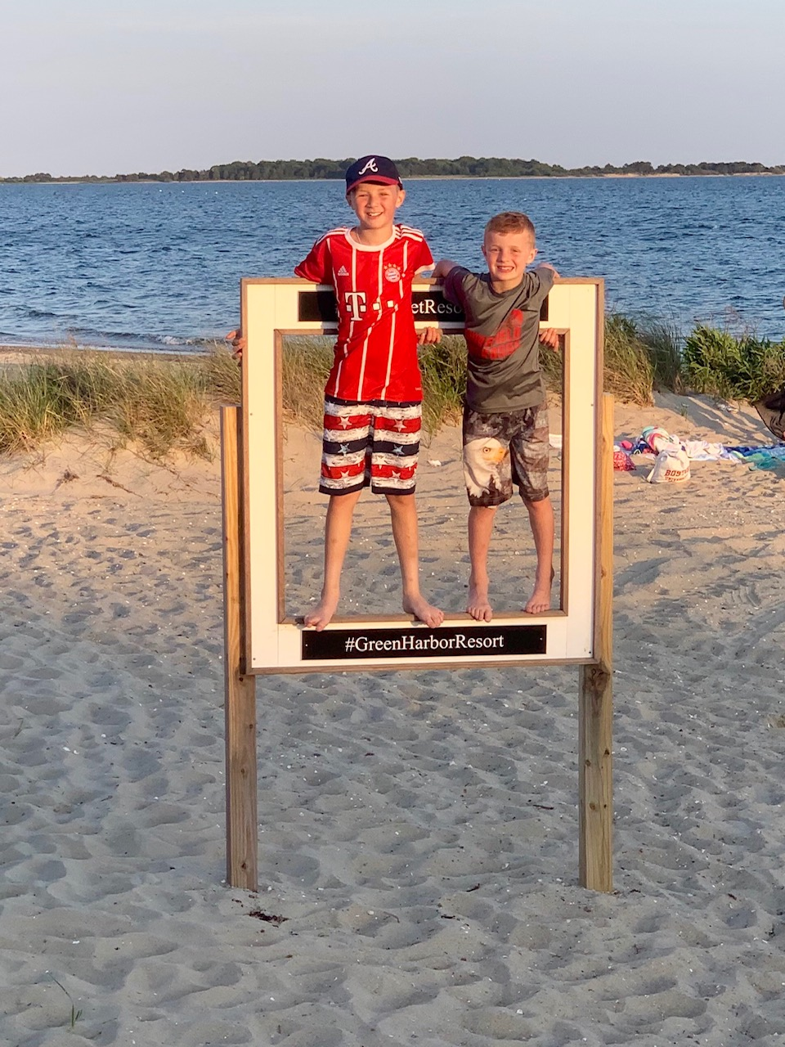
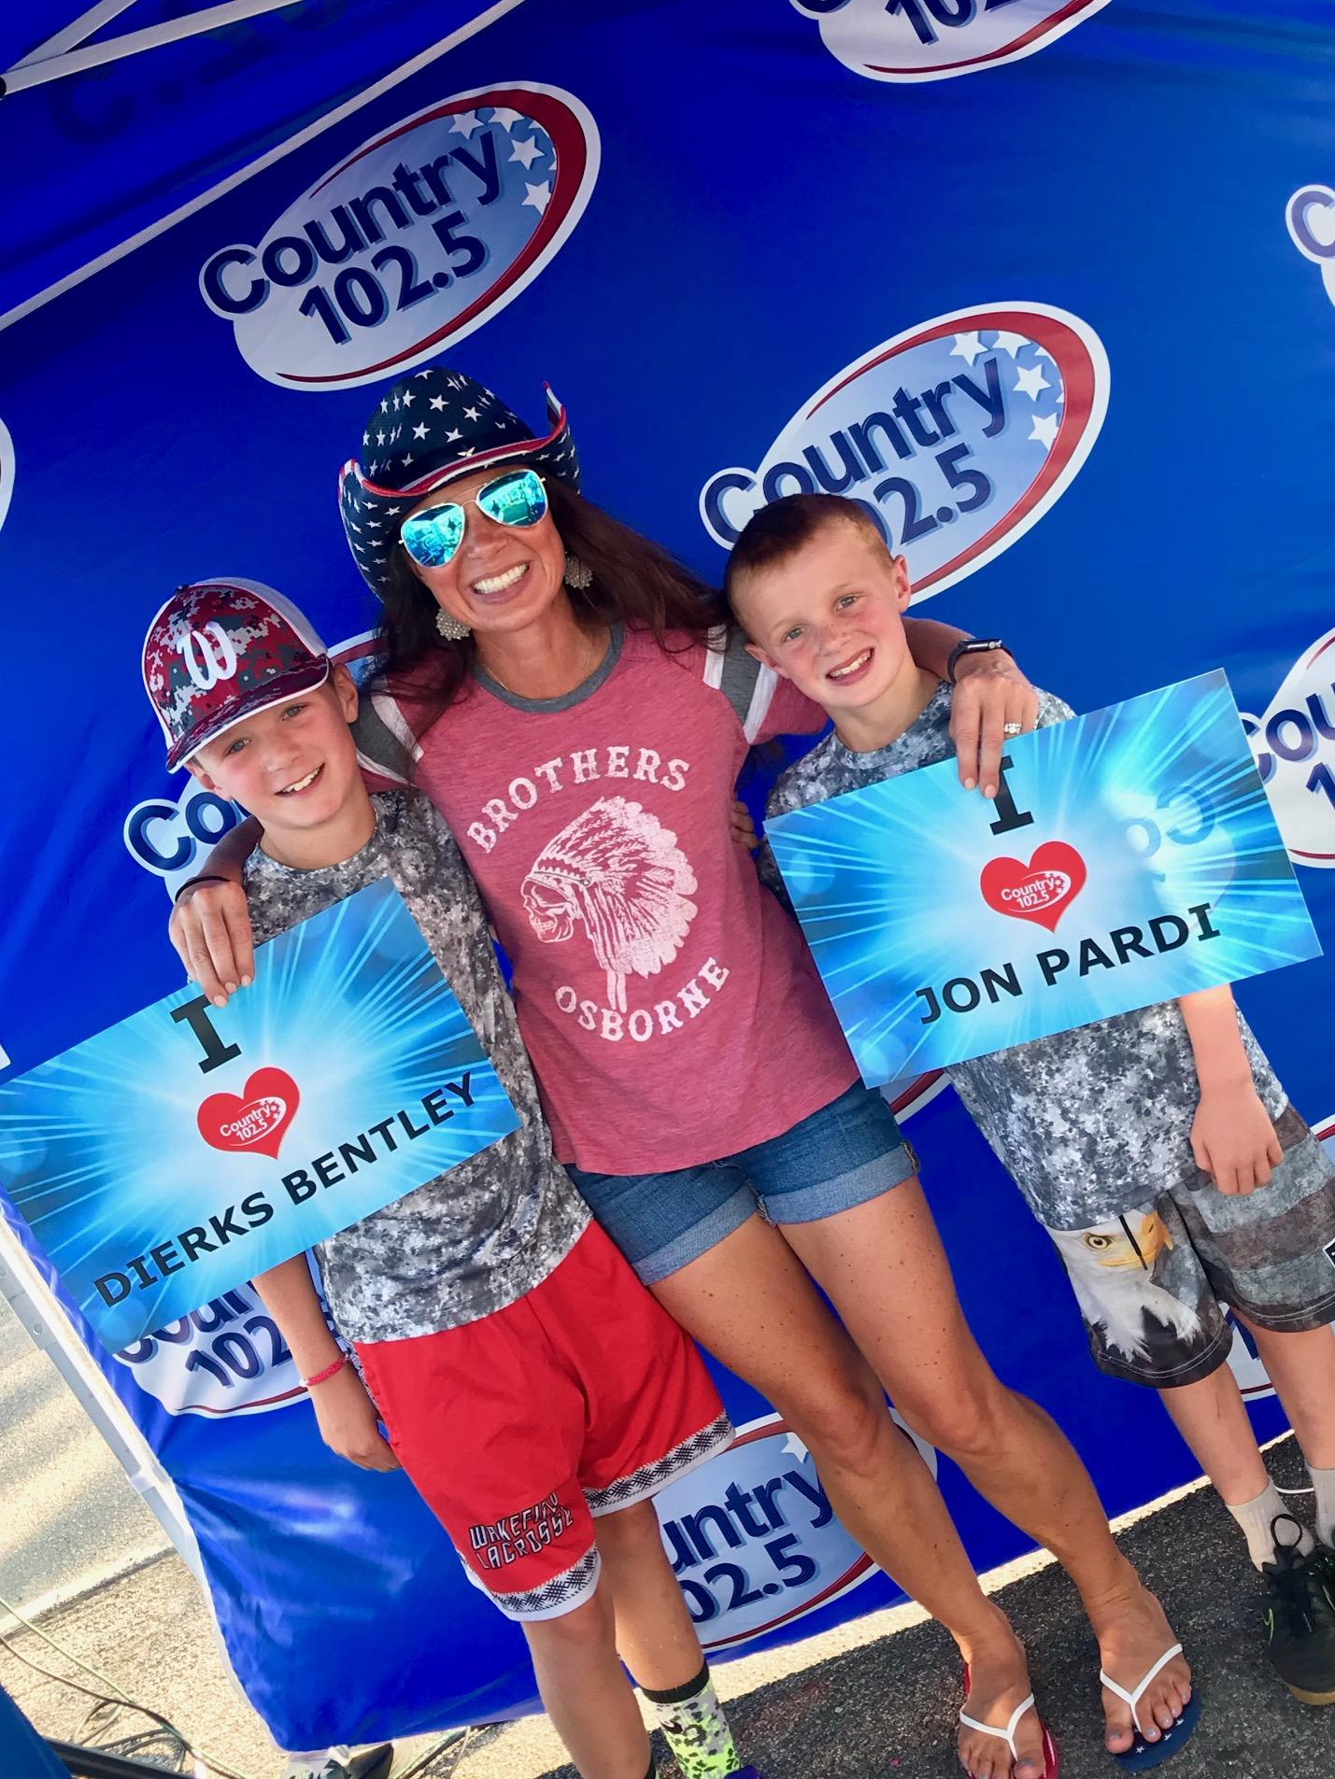
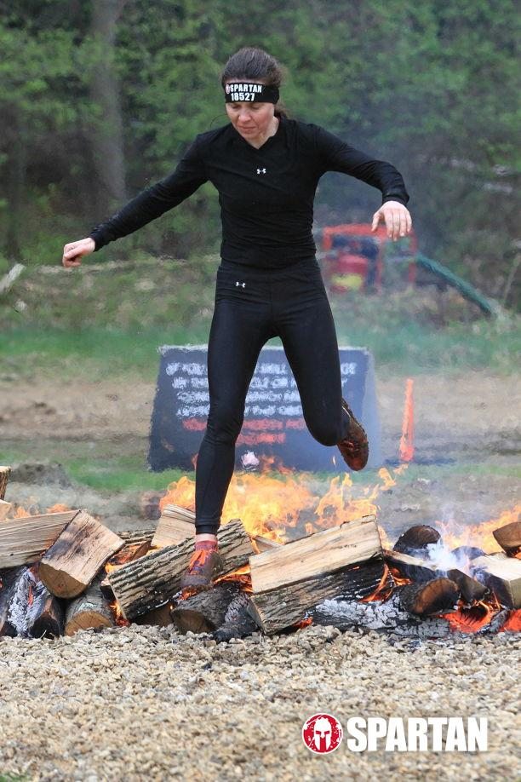
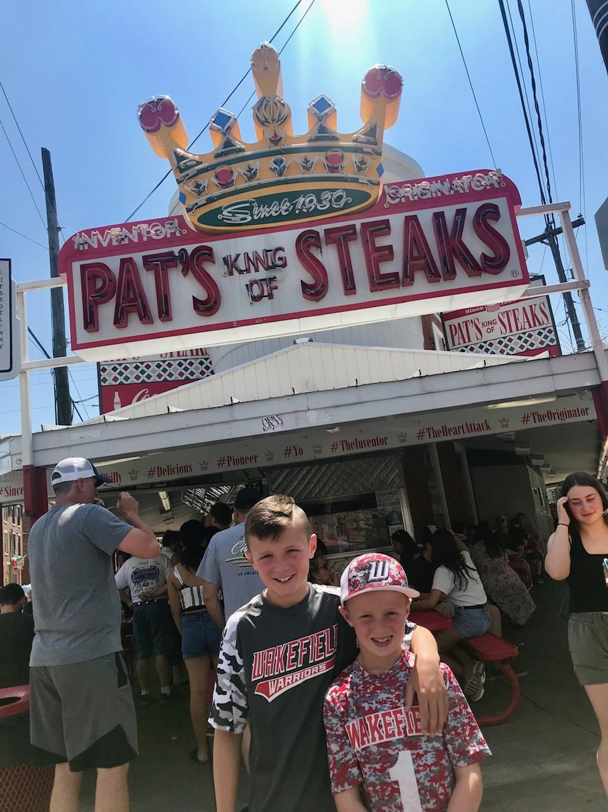
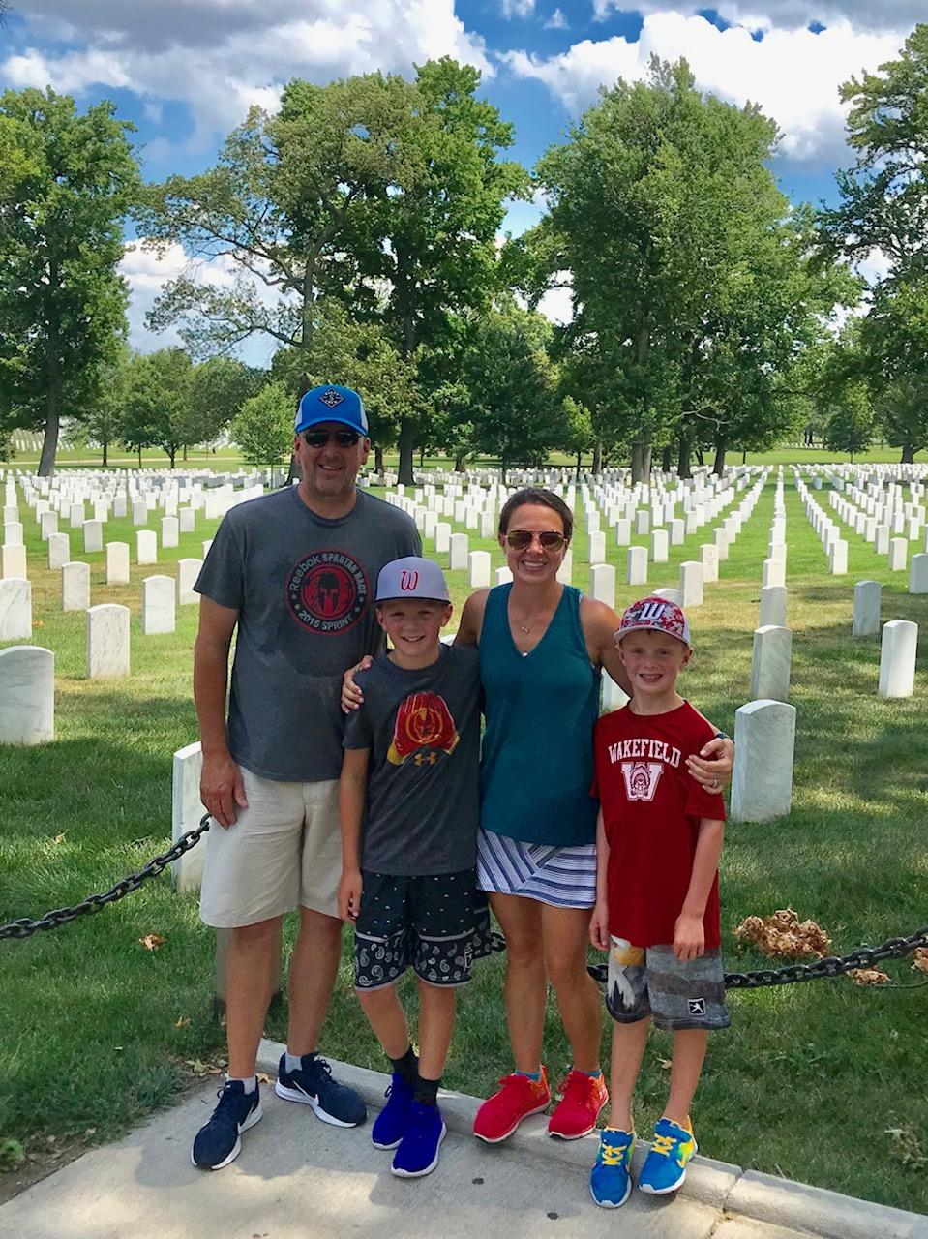
About Me
Winchester
Family
Sports
Travel
Music

Slide 6
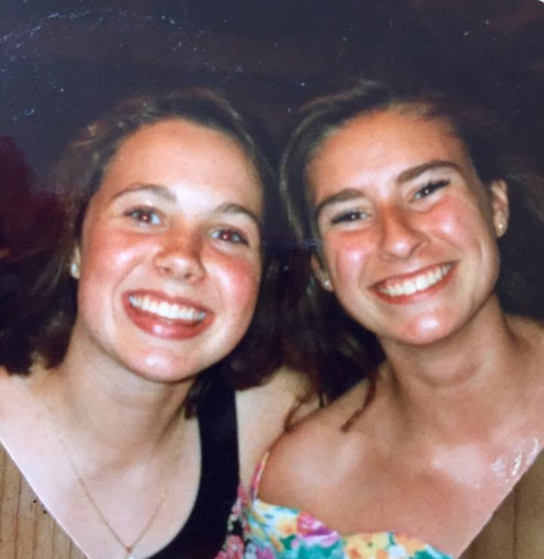
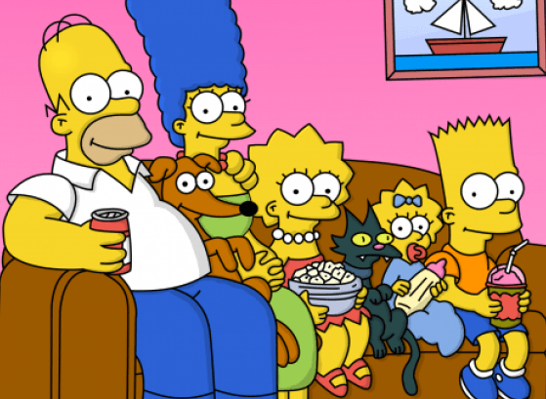
When I was a student at McCall . . .
I played softball and soccer. I was also a member of the Student Council and the Yearbook Committee.
My favorite television shows were Full House, The Fresh Prince of Bel-Air, Growing Pains and the Simpsons.
Popular Movies were Wayne’s World, The Mighty Ducks, A Few Good Men, and The Bodyguard.
I listened to music by Kris Kross, House of Pain, EnVogue and Def Leppard.

